Slide 1

Stock Price Prediction using Time Series Analysis
Authors:- Nilay Nisheethkumar Patel, Ashwani B Neminimadathil
Georgia State University, Atlanta

Slide 2
Outline
Introduction
Objectives
Models Used
Proposed Approach
Dataset Specifications
Model Implementation
Results
Insights
Limitations
Conclusion
References

Slide 3

Introduction
In the realm of finance, accurately predicting stock market movements is imperative for investors & financial institutions.
Stock market exhibits inherent volatility, non-linearity, and is susceptible to various economic, political, and psychological factors, making it difficult to model and forecast stock prices precisely using traditional methods.
By leveraging historical price data and advanced modeling techniques, there is a requirement to provide investors and traders with reliable forecasts to support informed decision-making in the dynamic financial markets.
Thus, a robust predictive model is built using time series analysis methods, including LSTM, ARIMA, SARIMA, and Fuzzy Time Series, to provide investors and traders with reliable forecasts supporting informed decision-making in dynamic financial markets.

Slide 4
Time Series Analysis
INTRODUCTION
Statistical methodology focusing on analyzing data points collected sequentially over time to identify patterns, trends, and seasonality.
Delves into the intricate dynamics inherent in market data, striving to unveil pivotal insights that shape future stock price movements.
Key CONCEPTS
Trend: Prolonged trajectory of a stock's price evolution across time; signifies overarching directionality (upward, downward or sideways)
Seasonality: Represents recurrent patterns manifesting at fixed intervals within the data, such as daily, weekly, monthly, yearly cycles.
Autocorrelation: Illuminates the temporal dependencies embedded within the data, facilitating an understanding of how past observations shape future outcomes.
Stationarity: Denotes the constancy of statistical properties, such as mean and variance, over time. Stationary data streamlines analysis efforts and augments prediction precision.

Slide 5

Objective
This study aims to evaluate and compare the effectiveness of various forecasting models, including LSTMs, ARIMA/SARIMA, Fuzzy Time Series, and an ensemble approach, for improved stock price prediction accuracy. We will assess their performance on real-world data using error metrics like RMSE to identify the most promising technique, particularly for capturing seasonal patterns in stock market dynamics.

Slide 6
Models Used
Long Short-Term Memory Networks (LSTM): Utilizes deep learning to model long-term dependencies in stock price sequences, capturing patterns that are not apparent to human analysts or traditional methods.
Autoregressive Integrated Moving Average (ARIMA): Models time series data based on its own past values (autoregression), the integrated part of the model accounts for the trends, making the time series stationary.
Seasonal ARIMA (SARIMA): Extends ARIMA to account for seasonal effects, which is particularly useful for stocks with patterns that repeat over a set period.
Fuzzy Time Series: Applies fuzzy logic to handle the uncertainty and imprecision inherent in financial time series data, providing a flexible approach that can adapt to the fuzzy nature of market dynamics.
Ensemble Models: Combines predictions from various models to leverage their individual strengths, reduce the impact of any single model’s weaknesses, and improve overall forecasting accuracy.

Slide 7
Proposed Approach
Data Collection: Gathered historical stock price data for Apple stock from Kaggle, encompassing open, high, low, close prices, and trading volume.
Data Preprocessing: Cleaned the dataset to address missing values, outliers, and formatting inconsistencies, ensuring uniform formatting and indexing by date.
Model Selection: Selected time series analysis methods viz. LSTM, ARIMA, SARIMA, Fuzzy Time Series, Ensemble Model
Training and Evaluation: Conducted model training using appropriate training-validation splits on the historical stock price data. Utilized performance metrics such as AIC (Akaike Information Criterion), BIC (Bayesian Information Criterion), and RMSE (Root Mean Squared Error) to assess model performance and ascertain their efficacy.
Ensemble Modeling: Explored ensemble modeling techniques to amalgamate forecasts generated by individual models into a consolidated prediction.
Comparison: Based on performance evaluations using established metrics and results derived from test data, determined the optimal model for stock price prediction.

Slide 8
Dataset Specifications
Data source:
Stock price data for Apple Inc. from Kaggle.
DATA FEATURES:
Open: Price of stock at the beginning of trading day.
High: Highest price of stock during the trading day.
Low: Lowest price of stock during the trading day.
Close: Price of stock at the closing of the trading day.
Adjusted Close: Stock's closing price after accounting for dividends, stock splits, and other adjustments.
Volume: No. of shares traded during the trading day.

Slide 9
Long Short-Term Memory Networks
Specifically designed to handle long-term dependencies in sequential data.
Use memory cells with gates (forget, input, output gate) that control the flow of information, determining what information is remembered over time, added, and the output.
Process information one step at a time, updating their internal state based on the current input & past information.
Advantages:
Learning Long-Term Patterns: Capture complex relationships and patterns in data even when they occur over long timescales.
Improved Performance on Sequential Tasks: Achieve better performance on tasks involving sequential data due to their ability to remember and utilize past information.
Limitations:
Computational Cost: Expensive, especially for large datasets or complex architectures.
Data Dependency: Rely heavily on the quality and quantity of training data.
Interpretability: LSTMs can be challenging to interpret compared to simpler models.

Slide 10
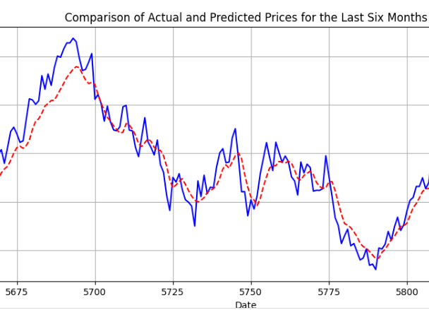
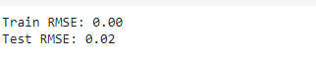
Stock Price Forecast using LSTM
:
Number of Layers: 2 LSTM layers.
Units per Layer: 50 units
Optimizer: Adam.
Loss Function: Mean Squared Error (MSE).

Slide 11
ARIMA SARIMA
Autoregressive Integrated Moving Average:
Uses past values (autoregressive) and error averages (moving average) to predict future values.
Requires stationary data (constant mean, variance over time).
Good for understanding factors influencing predictions (interpretable).
Efficient but struggles with strong seasonality.
Seasonal ARIMA:
Extension of ARIMA that captures seasonal patterns.
Includes additional parameters to model seasonal effects.
Effective for data with recurring patterns (e.g., monthly sales).
More complex to set up due to additional parameters.
Might require more data to capture seasonality effectively.

Slide 12
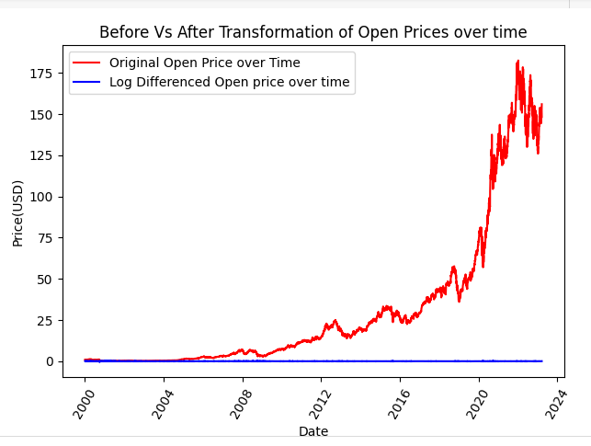
Augmented Dickey-Fuller (ADF) Test:
To ensure the effectiveness of ARIMA and SARIMA models, we employed ADF test for robust stationarity analysis.
Evaluates the null hypothesis of a unit root (non-stationary) against the alternative of stationarity.
By analyzing the ADF test's p-value, we determine if the data requires differencing to achieve stationarity for optimal model performance.
Log Differencing:
This transformation aims to achieve stationarity by capturing linear trends within the data, making it suitable for optimal performance of the ARIMA/SARIMA models.

Slide 13
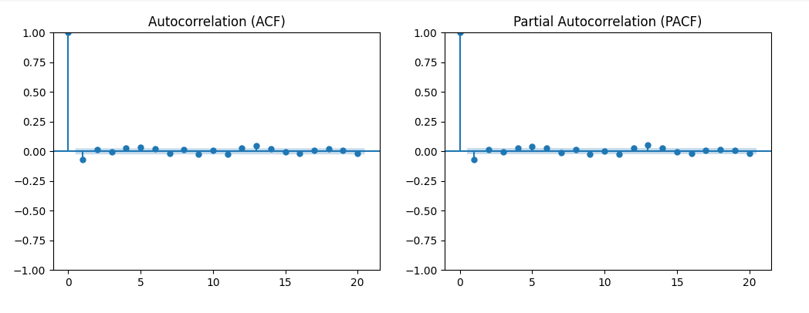
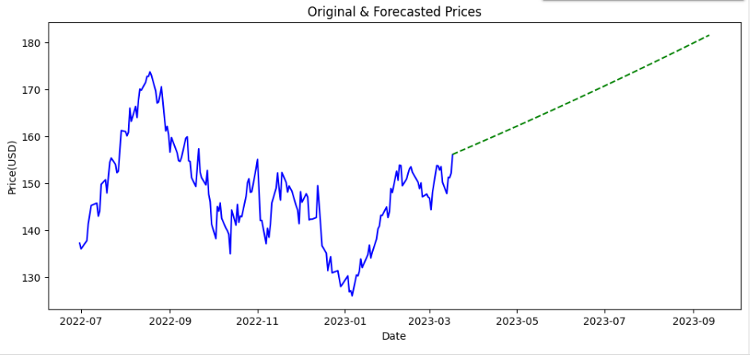
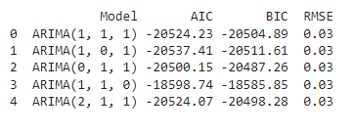
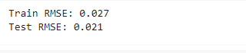
Stock Price Forecast using ARIMA

Slide 14
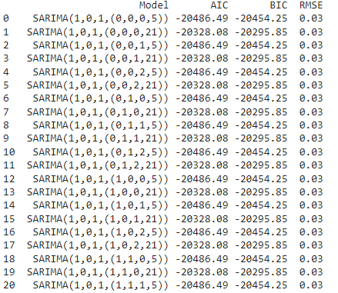
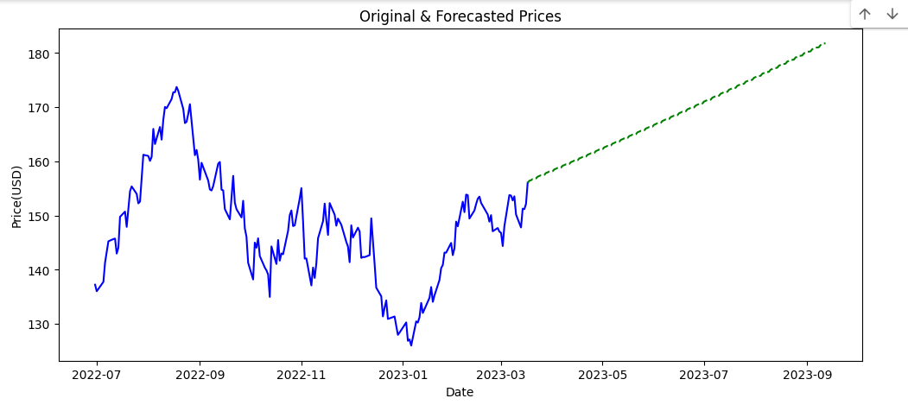
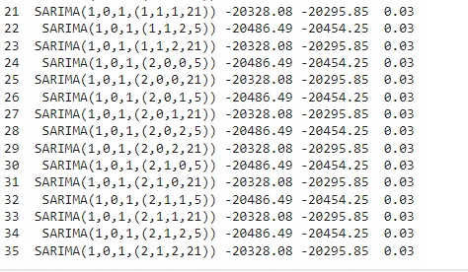
Stock Price Forecast using SARIMA

Slide 15
Ensembled Model LSTM, ARIMA, SARIMA
Ensemble learning:
Combine forecasts from separate models ( weighted averaging).
Leverages:
LSTM's ability to capture complex, non-linear patterns in data.
ARIMA/SARIMA's effectiveness with trends, seasonality & stationarity.
Potential:
Improved forecasting accuracy compared to using individual models.
More robust predictions by addressing limitations of each model.
Complexity:
Increased complexity compared to individual models. Evaluate the trade-off between accuracy and ease of implementation.

Slide 16
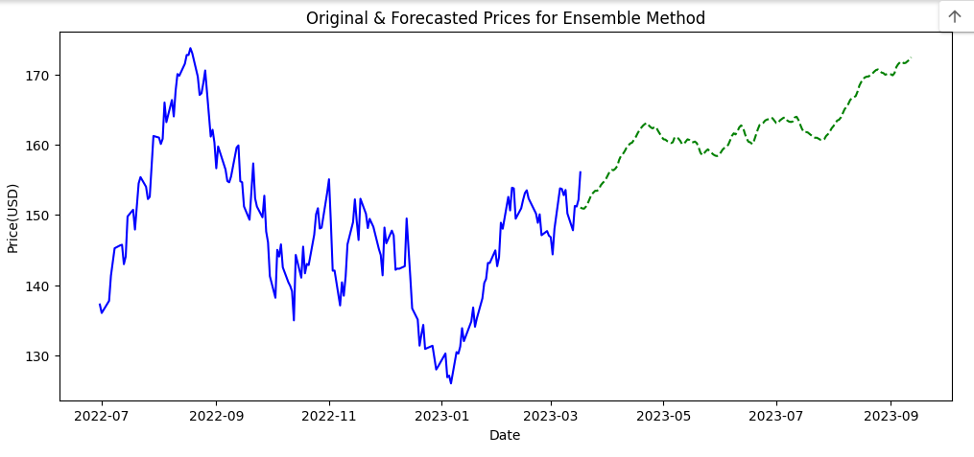
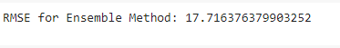
Stock Price Forecast using Ensemble Model

Slide 17
FUZZY TIME SERIES
Address the limitations of traditional statistical models in capturing the inherent uncertainty and vagueness present in real-world time series data.
Leverage fuzzy logic principles to represent time series data and relationships between data points using fuzzy sets and linguistic variables.
Instead of precise numerical values, fuzzy sets represent varying degrees of membership in categories (e.g., "high," "medium," "low" sales volume).
Fuzzy rules then govern the transitions between these fuzzy states.
Advantages:
Incorporates Uncertainty
Integrates Qualitative factors like sentiment analysis or expert opinions, into the forecasting process.
Challenges:
Subjectivity in Design: Defining membership functions for fuzzy sets and establishing fuzzy rules can be subjective.
Less Interpretable, making it difficult to understand the reasoning behind specific predictions.

Slide 18
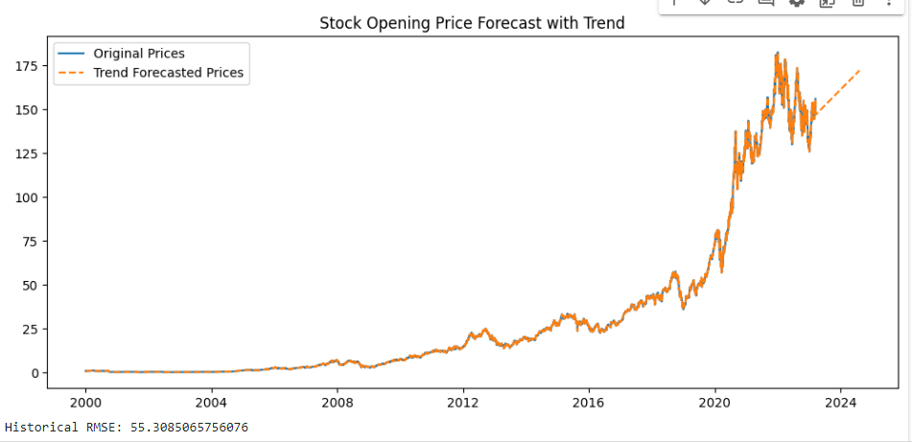
Stock Price Forecast using Fuzzy Time Series Model

Slide 19

Results
The SARIMA model demonstrated the highest accuracy among all tested models, achieving the lowest RMSE scores. This model effectively captured both seasonal trends and non-seasonal fluctuations in Apple Inc.'s stock price data.
While the LSTM model adeptly handled long-term dependencies and the Fuzzy Time Series model managed the uncertainty in the data, neither outperformed SARIMA in terms of overall precision in forecasting.

Slide 20
Limitations
While the study provided valuable insights, it encountered limitations such as the scope of data, which was confined to one stock ticker over a specific period. Additionally, model biases and the exclusion of external economic factors could have influenced the forecasting outcomes.
The complexity introduced by integrating multiple models also raised computational demands and significant number of model interpretability issues.

Slide 21
Conclusion
Time series analysis is a powerful tool for stock prediction, offering investors and traders valuable insights into the complex dynamics of the stock market.
The comprehensive evaluation highlighted SARIMA as the most effective model for forecasting Apple Inc.'s stock prices due to its ability to handle seasonal variations and trends.
The insights derived from this study can significantly aid financial analysts and investors in making more informed decisions.

Slide 22
References
S. Selvin, R. Vinayakumar, E.A. Gopalakrishnan, V.K. Menon, K.P. Soman, "Stock price prediction using LSTM, RNN and CNN-sliding window model," International Conference on Advances in Computing, Communications and Informatics (ICACCI), pp. 1643-1647, 2017.
Greff, K., Srivastava, R. K., Koutník, J., Steppner, B., & Schmidhuber, J. (2017). LSTM: A search space odyssey. IEEE transactions on neural networks and learning machines, 28(10), 2215-2229.
E. Chong, C. Han, F.C. Park, "Deep learning networks for stock market analysis and prediction: Methodology, data representations, and case studies," Expert Systems with Applications, vol. 83, pp. 187-205, 2017.
T. Tran, D. Pham, "Ensemble forecasting for stock market prediction," International Conference on Knowledge and Systems Engineering (KSE), pp. 292-297, 2017.
G.P. Zhang, "Time series forecasting using a hybrid ARIMA and neural network model," Neurocomputing, vol. 50, pp. 159-175, 2003.
R. Adhikari, R.K. Agrawal, "An introductory study on time series modeling and forecasting," LAP Lambert Academic Publishing, 2013.
S. Shen, H. Jiang, T. Zhang, "Stock market forecasting using machine learning algorithms," Technical Report, Department of Electrical Engineering, Stanford University, 2012.
I.S.K. Engin, V.V. Sivakumar, V.G. Kerone, "Fuzzy time series forecasting model based on fuzzy logic and artificial neural networks," IEEE International Conference on Fuzzy Systems, pp. 236-241, 2004.
T.H.K. Yu, K.H. Huarng, "A neural network-based fuzzy time series model to improve forecasting," Expert Systems with Applications, vol. 37, no. 4, pp. 3366-3372, 2010.
S.M. Chen, J.R. Hwang, "Temperature prediction using fuzzy time series," IEEE Transactions on Systems, Man, and Cybernetics, Part B (Cybernetics), vol. 30, no. 2, pp. 263-275, 2000.
Shafi, M. I., Farooq, U., & Raza, M. S. (2020). A comparative study of ARIMA, LSTM and ensemble machine learning models for stock price prediction. International Journal of Pattern Recognition and Artificial Intelligence, 34(01), 2050002.

Slide 23
Thank You!

